Slide 1
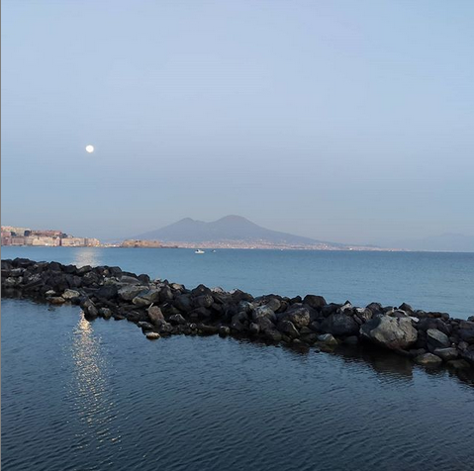

A beautiful city
for a good
investment
Dr. Claudio Calamita – Physicist – Data Scientist

Slide 2
Table of contents
Introduction
Analysis of the city
Data Collection
Descriptive analysis
Clustering K-Means
Model evaluation
Results
Conclusion

Slide 3
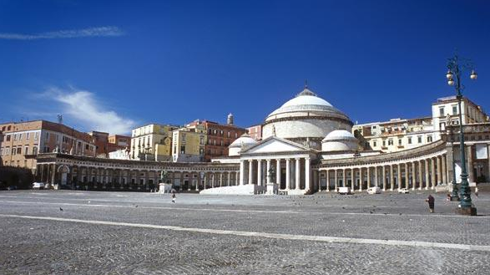
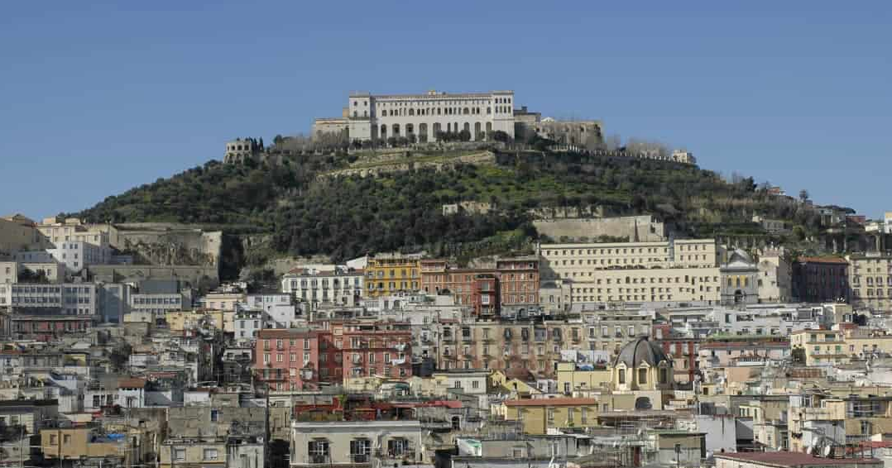
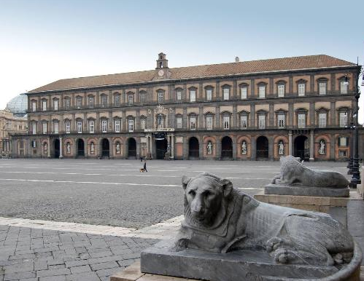
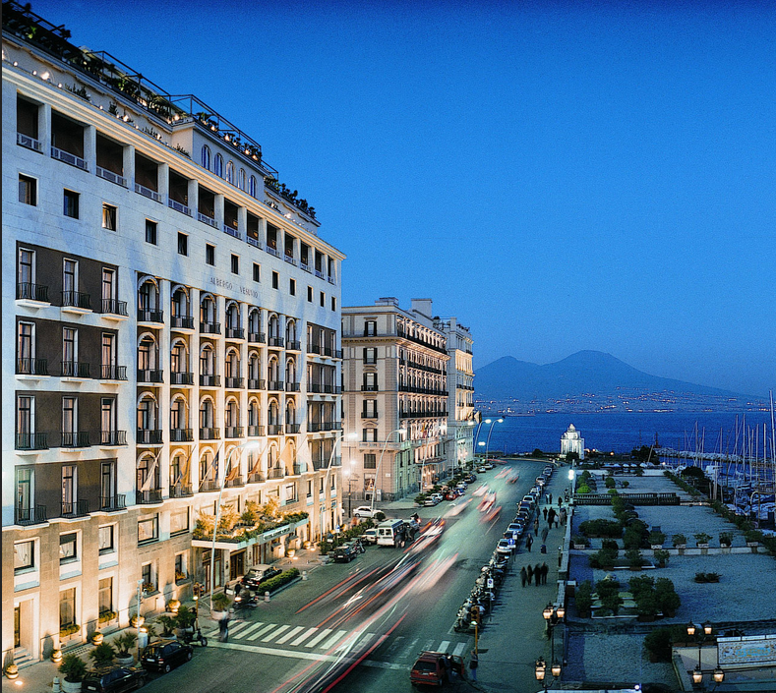
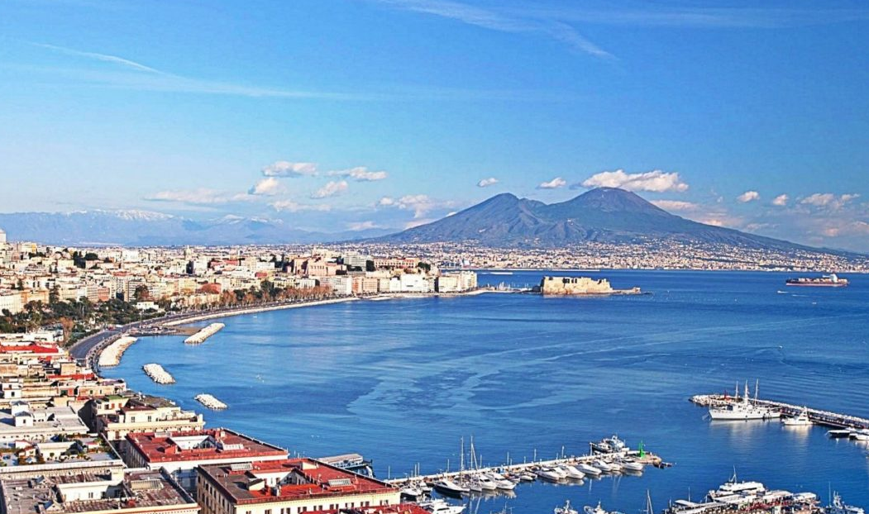
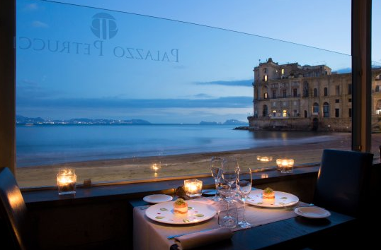
Introduction
Naples is a city of:
sea
art
history
culture
good food
very kind people
tourism
Naples is a wonderful city
for a good investment

Slide 4
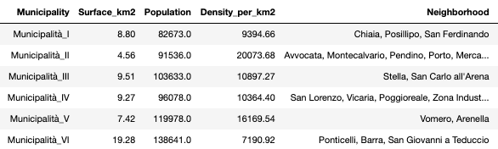
Analysis of the city
Economy of the city
City divided in municipality and neighborhoods
A good investment in:
hotels
restaurants
pizza places
coffe shops
Short Area but very high density of population --> venues are always full!

Slide 5
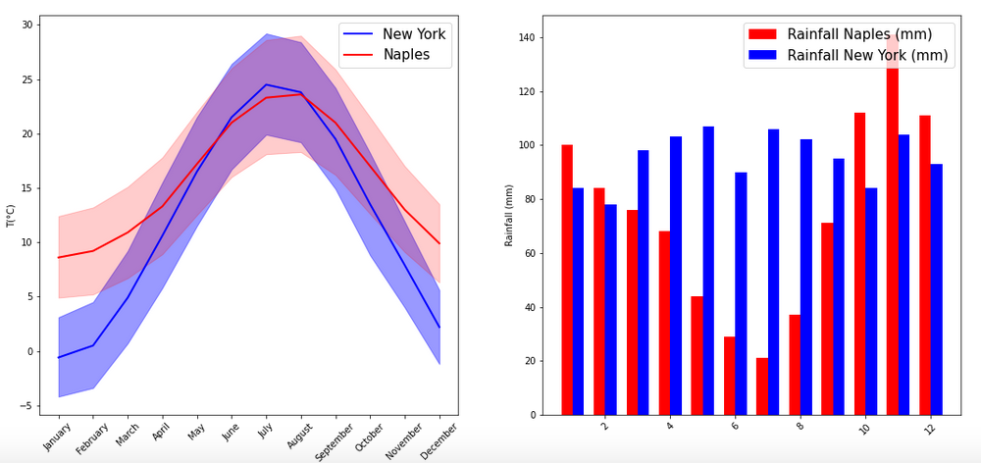
Analysis of the city
A very mild climate
Temperature over 10 °C all the year and few rainfall. Very good for tourism!

Slide 6
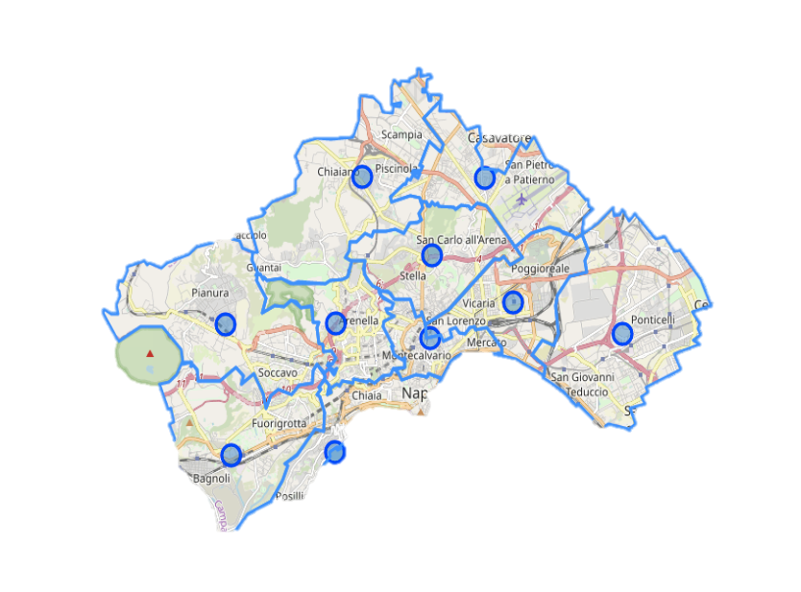
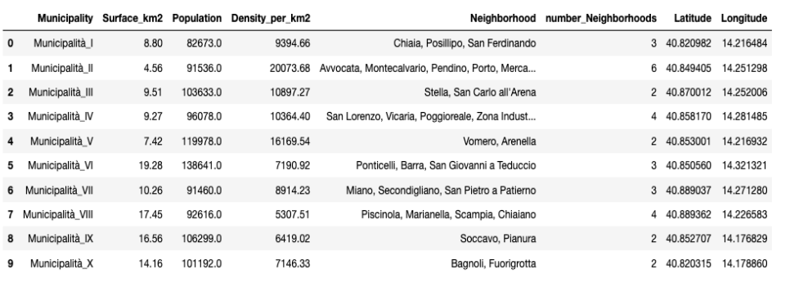
Data Collection
Locations and boundaries Municipalities
Foursquare API to get venues

Slide 7
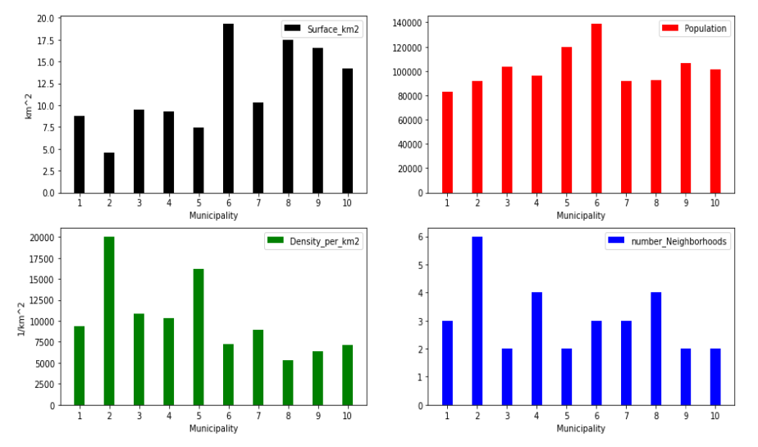
Descriptive analysis
Population concentrated in shortest municipalities
Municipality 2 could be a good candidate for an investment:
4 km² and 20000 population per km² and 6 neighborhoods

Slide 8
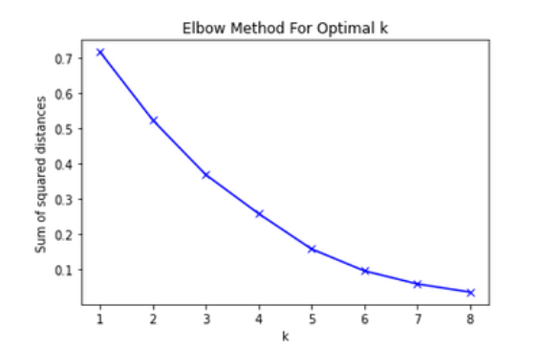
Clustering K-Means
Cluster K-Means to get similar clusters of municipalities by venues
Determine optimal K
with Elbow method
Best K = 4

Slide 9
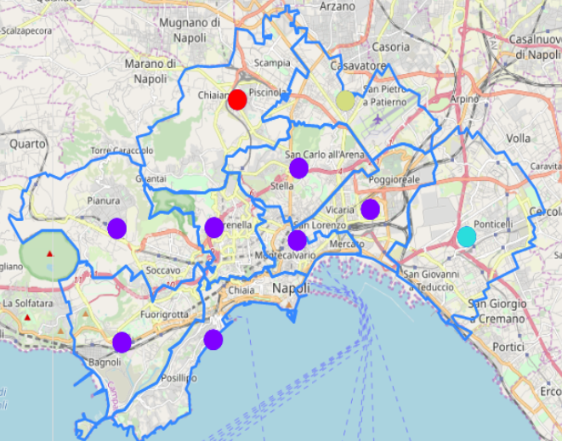
Cluster K-Means
3 cluster in periphery, characterized by train station, parks, supermarkets
1 cluster near the sea, characterized by hotels, restaurants, pizza places, bar, museums

Slide 10
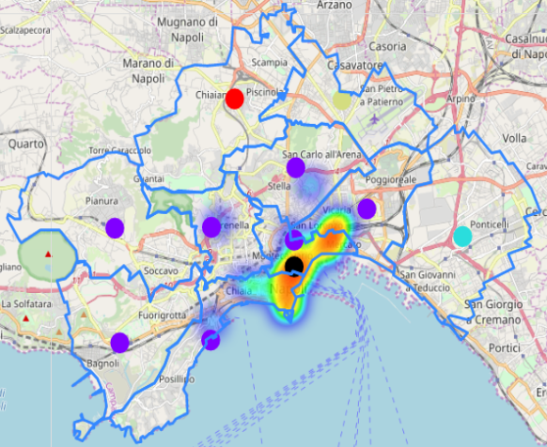
Model evaluation
Heatmap by categories as «Hotel»
’Hottest’ zone in Municipality 2!

Slide 11
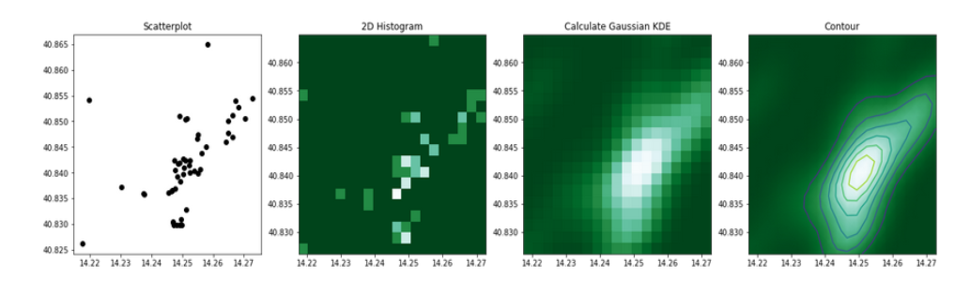
Model evaluation
Map latitude and longitude in a plane (true for short area)
Do 2d histogram, kde density plot and contour plot
Find most likely point as max of distribution in latitude, longitude

Slide 12
Model evaluation
The most likely point is in black on the map

Slide 13
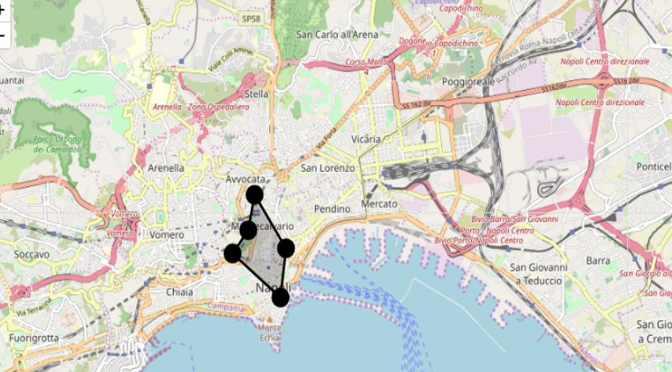
Results
Iterate the procedure for categories:
’hotel’, ‘restaurants’, ‘pizza’, ‘coffee’, ‘cocktails’
Get the most likely points
The points build a polygon
This could be a very reasonable area for an investment
As expected it is located in Municipality 2

Slide 14
Conclusion
In this project I analyzed Naples, a beautiful city,
rich of culture, with a good climate andhigh density of
population;
The city is structured in municipalities and neighborhoods;
I used Foursquare API to get data about venues;
I found 4 clusters. One of that is full of hotels,
restaurants, pizza places and is the historic part of
the city;
I plotted on heat-map these activities and found the best
location, more reasonable, using histo 2d plot;

Slide 15
Conclusion
I plotted all the best places on a map. These constitute a polygon. That could be a very reasonable area fora good investment.
The area is located in Municipality 2, the shortest with 4 km² and a very very high density of population, ~20000 people/km².
The analysis can be further extended going to consider other categories as food, gym or deepen those already considered as doing a research for a better location of Italian restaurant, Chinese restaurant and so on.

